Slide 1
Puppies & Kittens
by Kathy Smith

Slide 2
Initial Intake
Check for fleas, ticks, and warbles.
Check for hair loss (mange, ringworm)
Check Temperature
Check capillary refill
Check ears & eyes

Slide 3
Fleas on Puppies and Kittens

Slide 4
Ticks on Puppies and Kittens

Slide 5
Warbles in Puppies
and Kittens

Slide 6
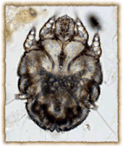
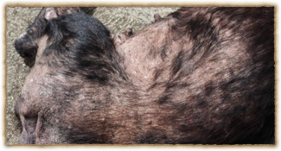
Sarcoptic Mange (Canine Scabies)
*Sarcoptic mange is a highly contagious skin disease found in dogs, caused by the Sarcoptes scabiei mite. These mites will burrow through the skin causing intense itching and irritation.*
Symptoms
Intense Scratching
Skin Rash
Crust formation in affected areas
Hair loss
Causes
The most common cause of mange in dogs is exposure to another infected animal, as the mites quickly move from animal to animal. The exposure generally occurs about two to six weeks before the first symptoms of mange are displayed.
Diagnosis
After ruling out food allergies, chiggers, and bacterial infections of the skin (folliculitis), your veterinarian will conduct a physicial inspection and possible skin scrape of your dog to identify the type of microorganism that may have embedded into its skin; in this case, mites.
Treatment
Scabicide -- a drug that kills the itch mite.
Scabicidal shampoo to kill all of the mites living in its skin.
**CONTAGIOUS**

Slide 7
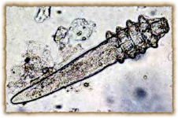
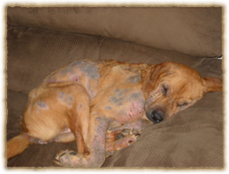
Demodectic Mange
*Demodectic mange, sometimes just called "demodex" or "red mange", is the most common form of mange in dogs. It is caused by the Demodex canis, a parasite that lives in the hair follicles of dogs.*
Symptoms
Lesions
Hair loss
Crusty, red skin
Greasy or moist appearance
Causes
It is generally a disease of young dogs that have inadequate or poorly developed immune systems or older dogs that are suffering from a suppressed immune system.
Diagnosis
Once Demodectic mange is suspected in a dog, it can usually be confirmed by a skin scraping or biopsy, in which case, the mites can be seen with the aid of a microscope. They are too small to be seen with the naked eye. The mite must be coupled with the lesions for a diagnosis of mange to be made.
Treatment
The treatment of Demodectic mange is usually accomplished with topical (on the skin) medications, though some oral medications are also used. Also Amitraz dips may be applied every two weeks. Amitraz is an organophosphate, and is generally available under the product name Mitaban. It is a prescription product and should be applied with care.

Slide 8
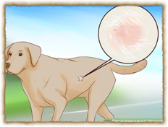
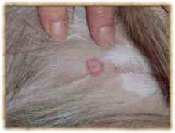
Ringworm
“Ringworm" is the common name given to a fungal infection of the superficial layers of the skin, hair and nails.
Symptoms
Dandruff
Poor hair coat/hair loss
Reddened skin/itchiness
Darkened Skin
Causes
Dogs most commonly develop ringworm because of infections with the fungi Microsporum canis, Microsporum gypseum, and Trichophyton mentagrophytes. Diseases or medications that decrease the body's ability to develop a normal immune response (known as immunocompromising diseases, or immunosuppressive medications, respectively) can increase the likelihood that your dog will be susceptible to a fungal infection
Diagnosis
Your veterinarian will perform a fungal culture of skin clippings, a microscopic examination of a sample of hair, and possibly a skin biopsy.
Treatment
Most dogs can be treated on an outpatient basis, but quarantine procedures should be considered due to the infective and zoonotic (transmittable to humans) nature of some types of dermatophytosis. If your veterinarian needs to prescribe antifungal medications, the use of an Elizabethan collar (a wide collar placed around the neck) is recommended to prevent ingestion of antifungal medications applied to the dog's skin.

Slide 9
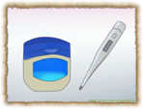
Temperature & Capillary Refill
Temperature
According to the American Kennel Club (AKC), a temperature of 101 to 102.5 degrees Fahrenheit (38.3 to 39.2 degrees Celsius) is typical for dogs.
Temperature for a kitten is 101.5
Capillary refill
The normal time it takes for the capillaries to refill in the dog and cat is 1.5 seconds. To assess blood flow, press on your pet's gums with a finger, and then release the pressure. When the pressure is released, the blood should almost immediately refill the capillaries.

Slide 10
Ear Mites

Slide 11
Eye Issues in Puppies and Kittens

Slide 12
Bath Time
What you need to bathe
Regular Dawn Dish Soap (Blue)
Towels
Nail Trimmer
Shallow dish ban or Bowl
How to bathe
Rinse, soap, re-rinse, towel dry completely

Slide 13
Warming

Slide 14
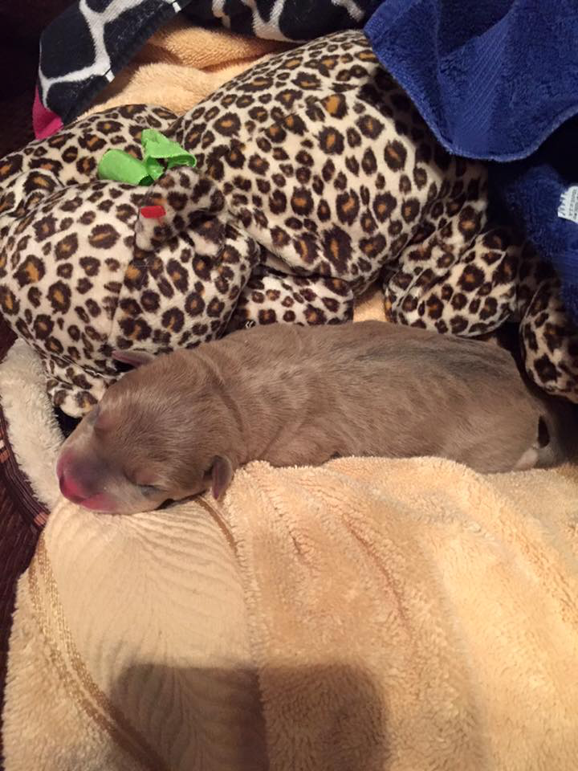
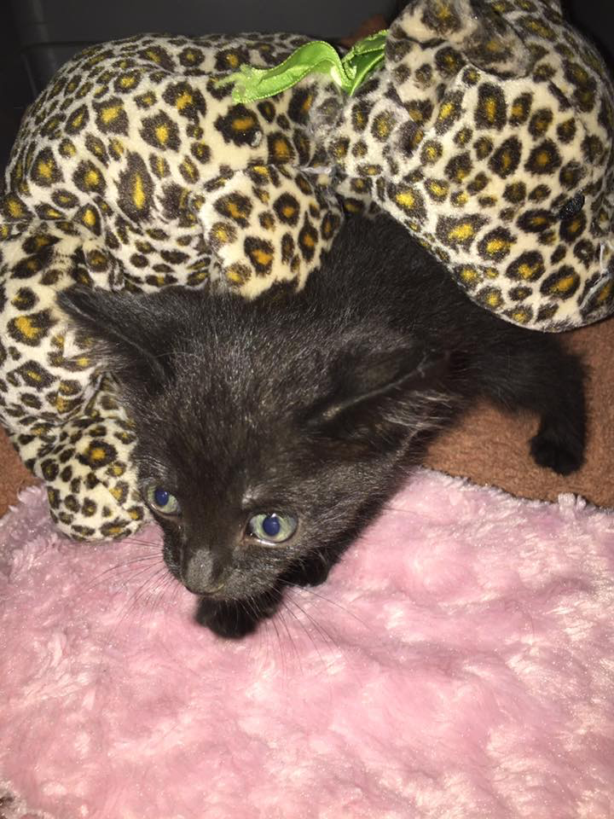
Bedding Prep & Cage Setup

Slide 15
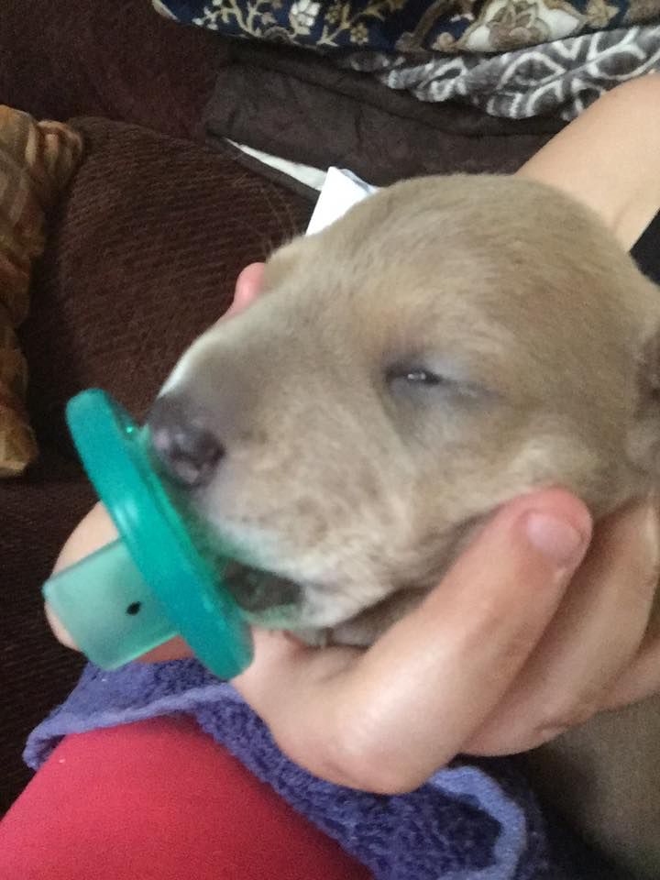
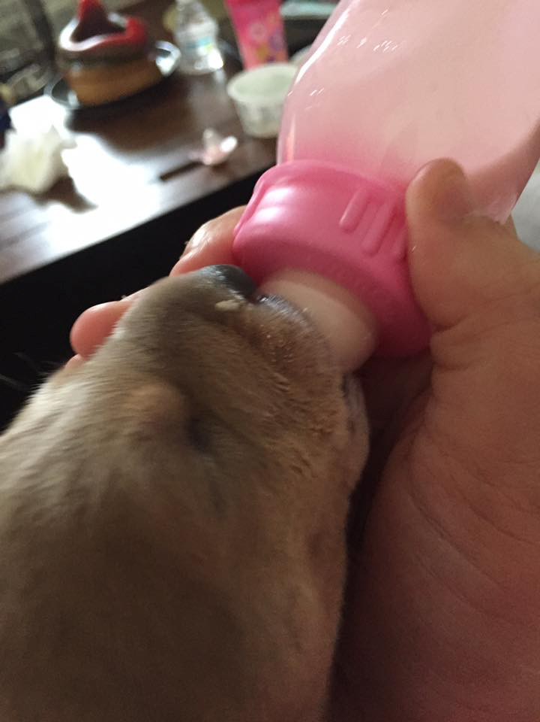
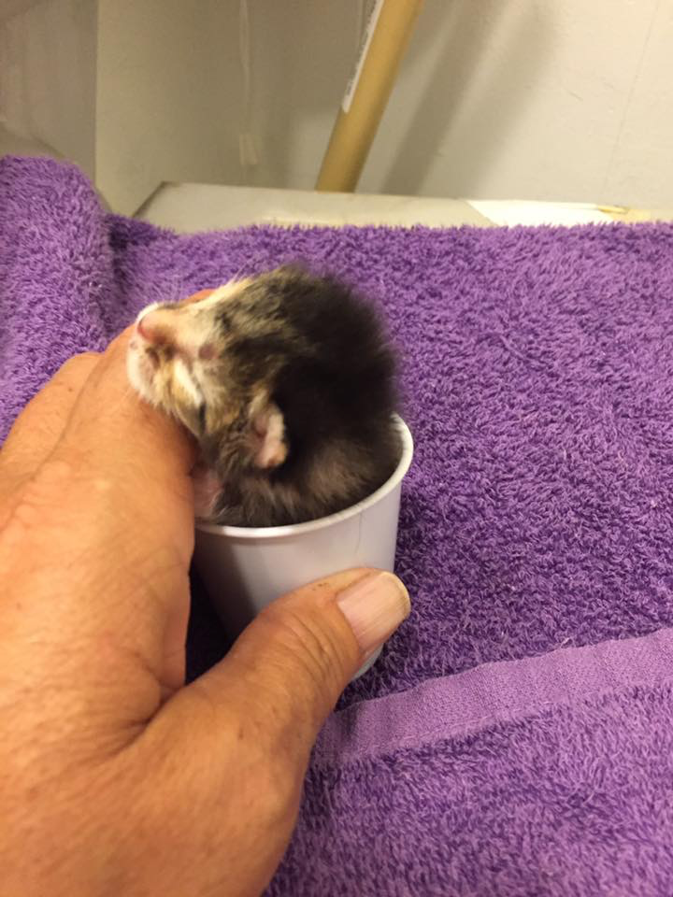
Feeding

Slide 16
Feeding Equipment

Slide 17
Stimulation

Slide 18
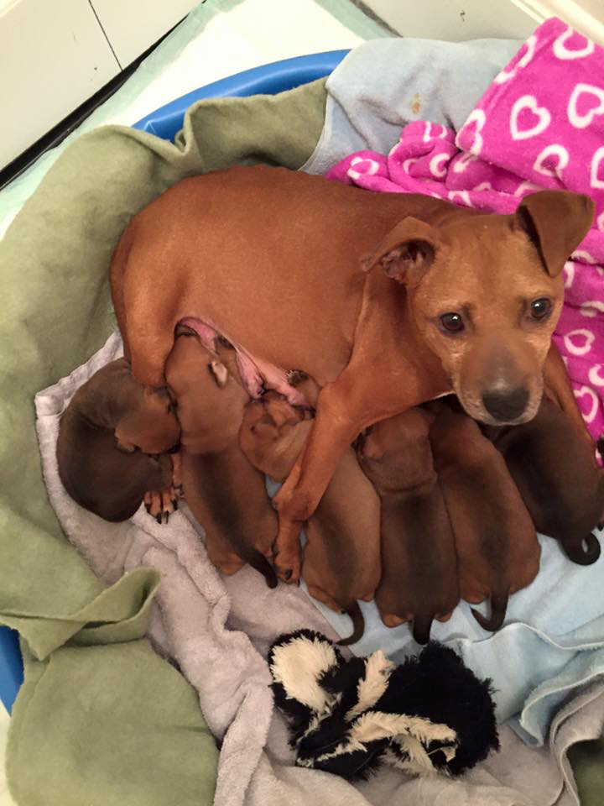
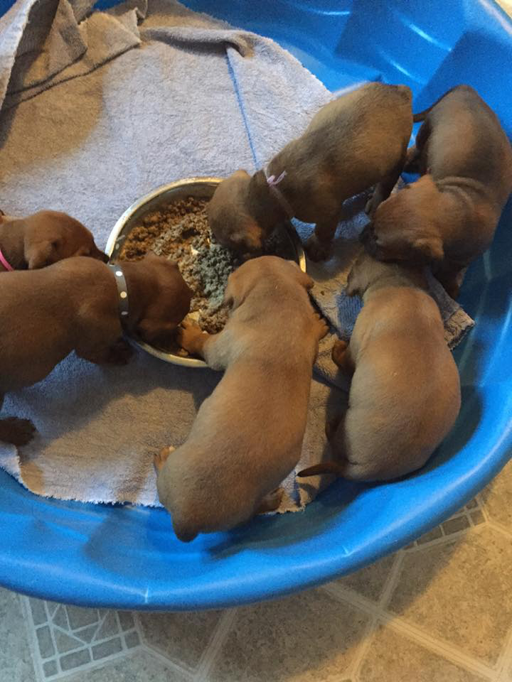
Weaning

Slide 19
Sub Q fluids

Slide 20
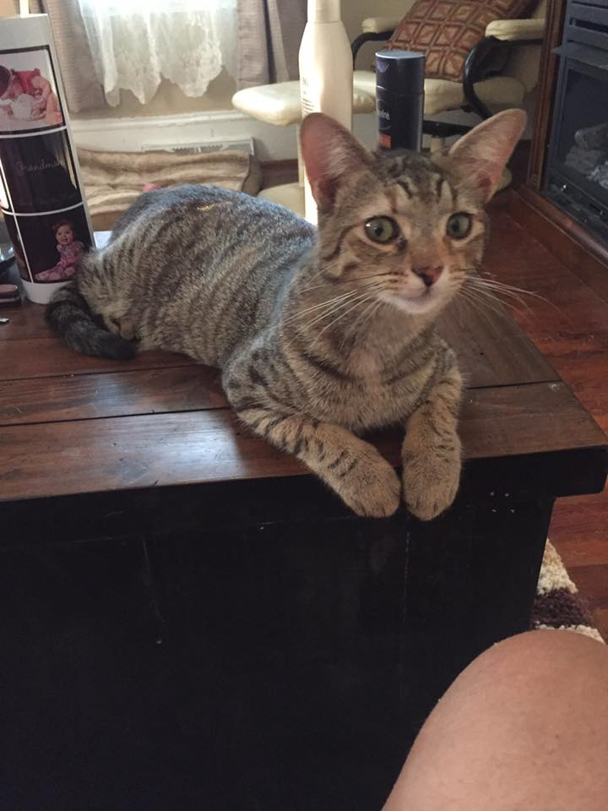
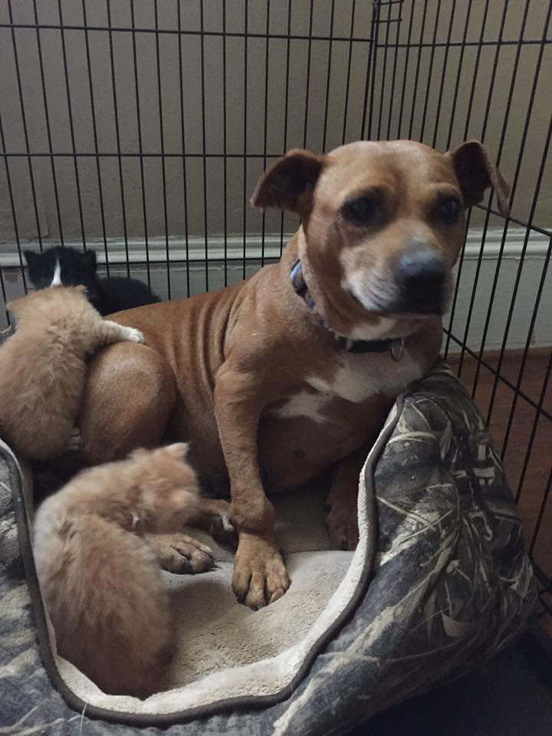
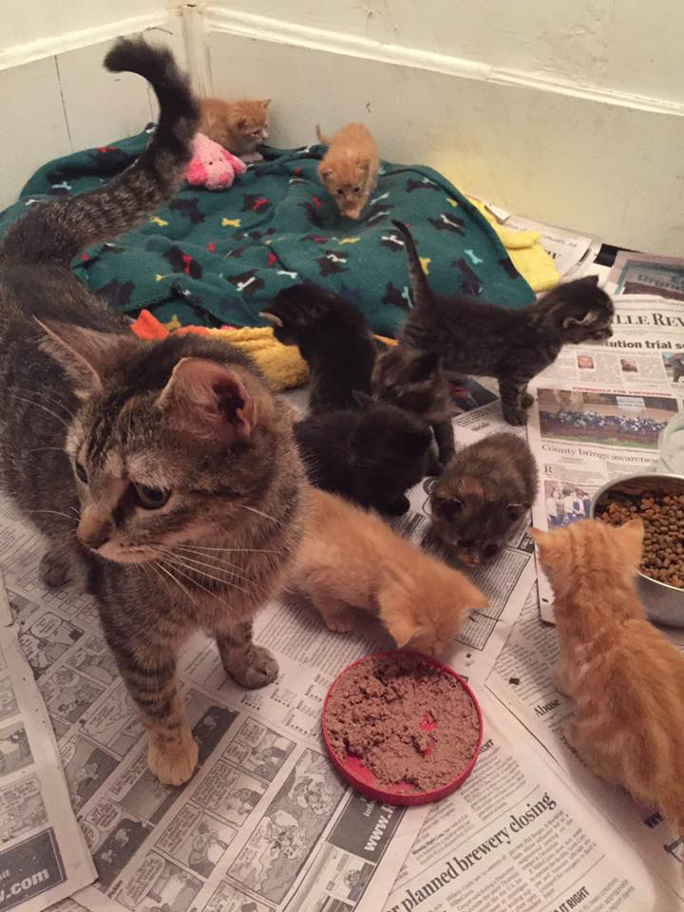
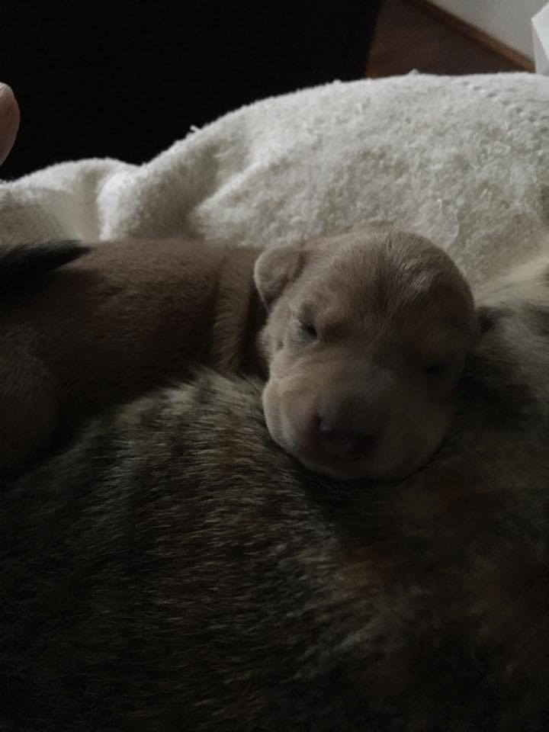
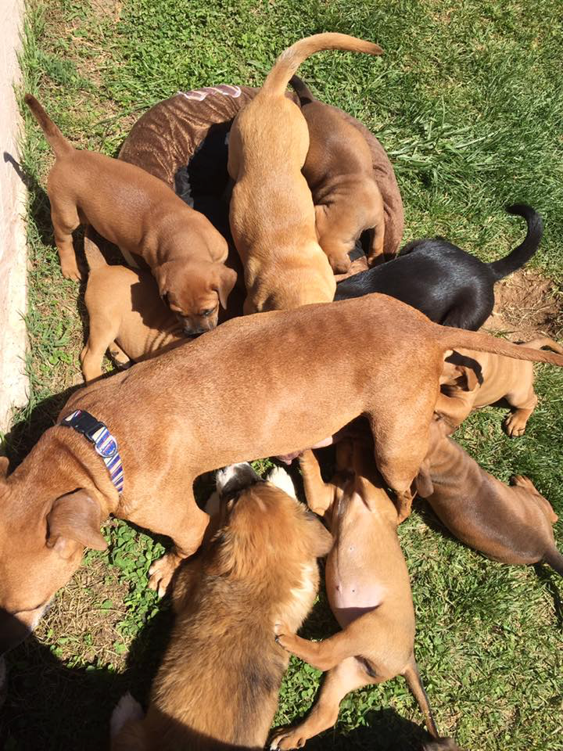
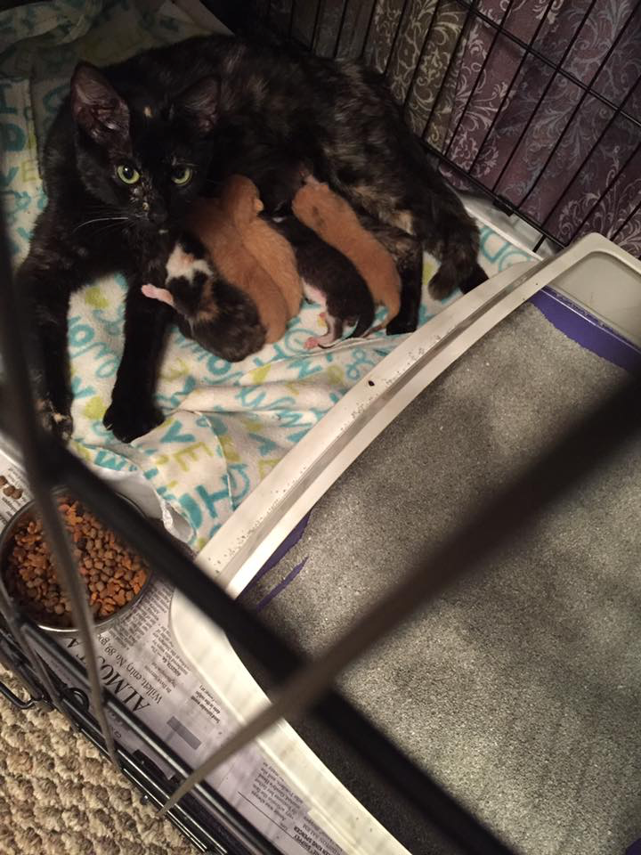
Assistants

