Slide 1
TNR (M)
Trap, Neuter, Return (Manage)

Slide 2
WHY TNR (M) TRAP, NEUTER, RETURN (MANAGE)
Trap and Euthanize has been practiced for more than 25 years. It isn’t working
One pair of breeding cats can produce up to 250,000 kittens in their lifetimes
50% or more of kittens born to community cats die
Unfixed cats can be behavioral problems (noise, fighting for mating and territorial rights, spraying). It can also increase the rates of many diseases in cats (FELV, FIV, FIP)
With proper support (food and shelter), cats can live comfortably outside

Slide 3
COMMUNITY CATS Also known as “feral,” “free roaming” or “wild” cats
Are the same as your pet cat
Have been abandoned, lost or dumped or are their offspring
Have not been socialized to humans and do not recognize hmans as helpful
Are survivors
Can be homeless but are not without support
Can become bonded to one another and to humans
If unfixed, a breeding pair can produce up to ¼ million cats in their lifetimes
Can live long, healthy lives with human support (TNR-M)

Slide 4
TRAPPING BASICS
Make sure the trap is clean and working
Place the trap on level ground
Secure the area to ensure the traps are not disturbed (add signs that tell people what’s going on)
If possible, talk to neighbors (to alert them and to recruit possible trap watchers)
Some trappers use trail cameras to record activity before and during trapping
Have a cover for the trap
Never leave the trap unattended, especially in extreme weather

Slide 5
TRAPPING BASICS
If possible, make the S/N appointment to occur within a day or so of trapping
Once trapped, cover the trap and place it on top of a pee pad or other waterproof tarp, plastic, etc.
Use a shed, a bathroom or a protected porch to hold the cat overnight, if needed
Recuperate boys overnight; girls need an extra day or so to ensure their stitches are healing
If a pregnancy has been terminated, plan to keep the cat for three to four days

Slide 6
TRAPPING DIFFICULT CATS
Tie the trap and feed ONLY in the trap for up to a week.
Monitor the trap to make sure the right cat (or critter) is eating
If needed for trap-savvy cats:
Use a drop trap and transfer cage
Use a large dog crate, modified as a trap
These two methods will be demonstrated

Slide 7
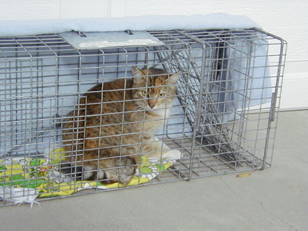
Guillotine Trap
Cat will probably not be this calm
Covering the trap will calm him down

Slide 8
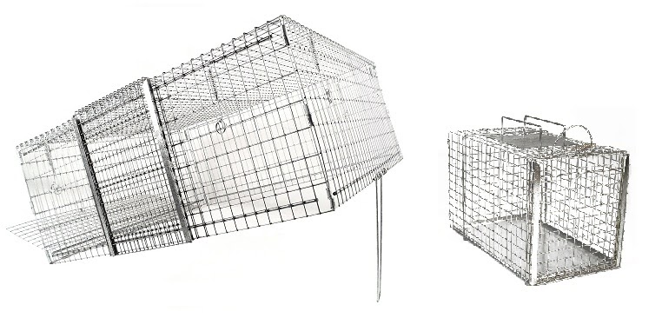
DROP TRAP and TRANSFER CAGE

Slide 9
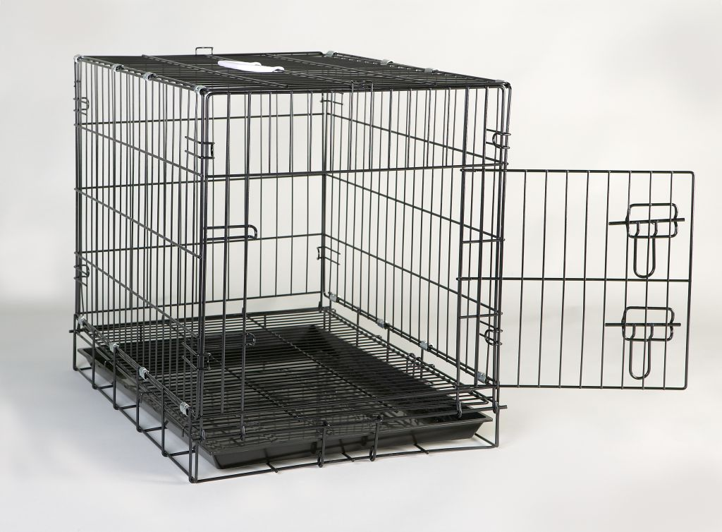
DOG CRATE CAN BE MODIFIED AS A TRAP

Slide 10
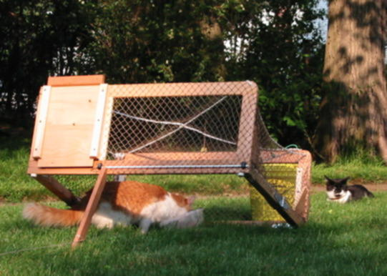

Slide 11
